Slide 1

LAB-6 Telnet & SSH
Computer Networks (CN)
DU #2301CS501
Prof. Maulik D Trivedi
Computer Engineering
maulik.trivedi@darshan.ac.in
+91-9998265805
Disclaimer: The images used in this presentation are sourced solely for educational and nonprofit purposes. The author of this presentation asserts no ownership or copyright claims over them."

Slide 2
What is Remote Access?
Remote access allows us to control another computer over a network.
It is widely used for server administration, cloud management, network configuration, IoT devices (Raspberry Pi), and virtual machines.
Examples
Linux Server
Cloud Server
Raspberry Pi
Cisco Router
Virtual Machine

Slide 3
What is Telnet?
Telnet is a protocol that allows users to remotely access and manage another computer over a network using a command-line interface.
Application Layer (Layer 7) remote access protocol.
Uses TCP Port 23 for communication.
Transmits all data, including usernames and passwords, in plain text.
Does not use encryption, making it vulnerable to packet sniffing and eavesdropping.
Commonly used in the past for server and network device management. Today, it has been largely replaced by SSH due to security concerns.

Slide 4
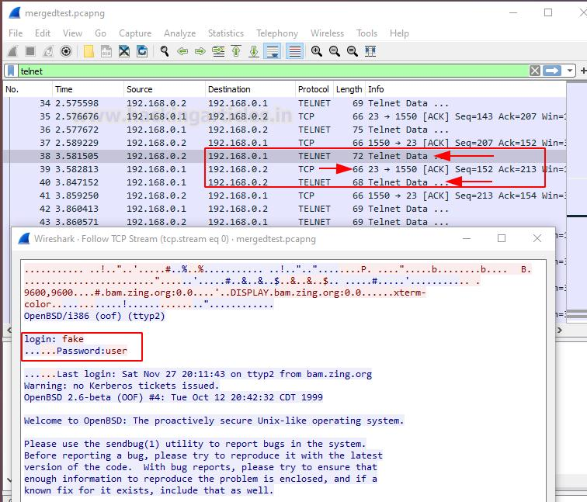
Telnet in WireShark

Slide 5
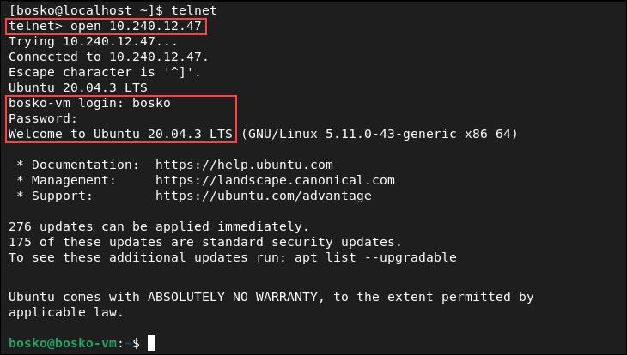
Connecting Telnet Client

Slide 6
What is SSH?
SSH (Secure Shell) is a cryptographic network protocol that enables secure remote login, command execution, and file transfer between networked devices.
Uses RSA public-key cryptography to provide secure authentication and establish encrypted communication.
It uses TCP Port 22 and protects communication through encryption, making it the standard protocol for secure remote administration.
Encrypts all transmitted data to protect against eavesdropping and attacks.
Ensures confidentiality, integrity, and authentication during communication. Supports password-based and public key-based authentication. Enables secure file transfers using SCP and SFTP.

Slide 7
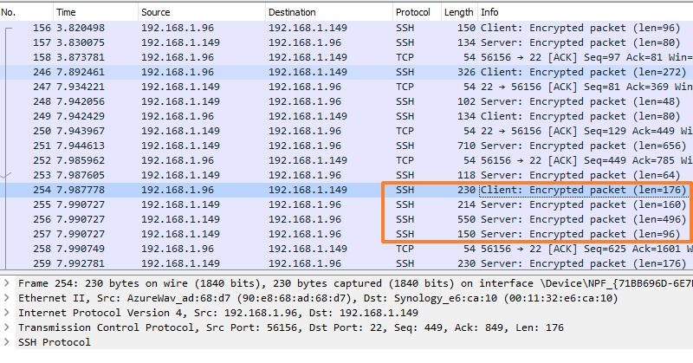
SSH In WireShark

Slide 8
Installing SSH Server (Linux/Kali/Ubuntu)
Install SSH Server
sudo apt update
sudo apt install openssh-server –y
Start Service
sudo systemctl enable ssh
sudo systemctl start ssh
Verify
sudo systemctl status ssh

Slide 9
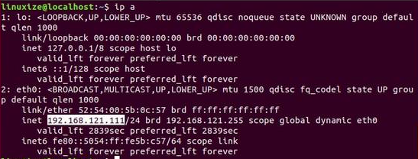
Find SSH Server IP
Get the IP Address of the SSH server
ip a
hostname -I
Example:
192.168.121.111

Slide 10
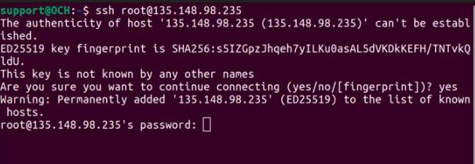
Connect Using SSH
Connect SSH Server
ssh username@135.148.98.235

Slide 11
Installing Putty
Linux (Debian)
sudo apt update
sudo apt install putty
MacOS
brew install putty
Windows
https://www.chiark.greenend.org.uk/~sgtatham/putty/latest.html

Slide 12
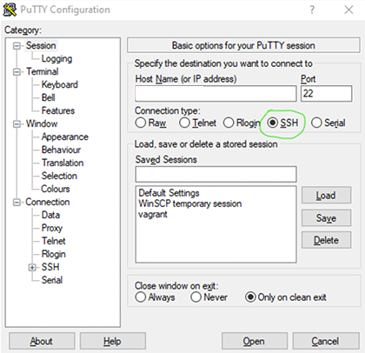
Connecting SSH with Putty
Enter the Server IP Address in Host Name.
Select the Connection Type (SSH or Telnet).
Verify the Port Number (22 for SSH, 23 for Telnet).
Click Open to establish the connection.
Enter your username and password when prompted.

Slide 13
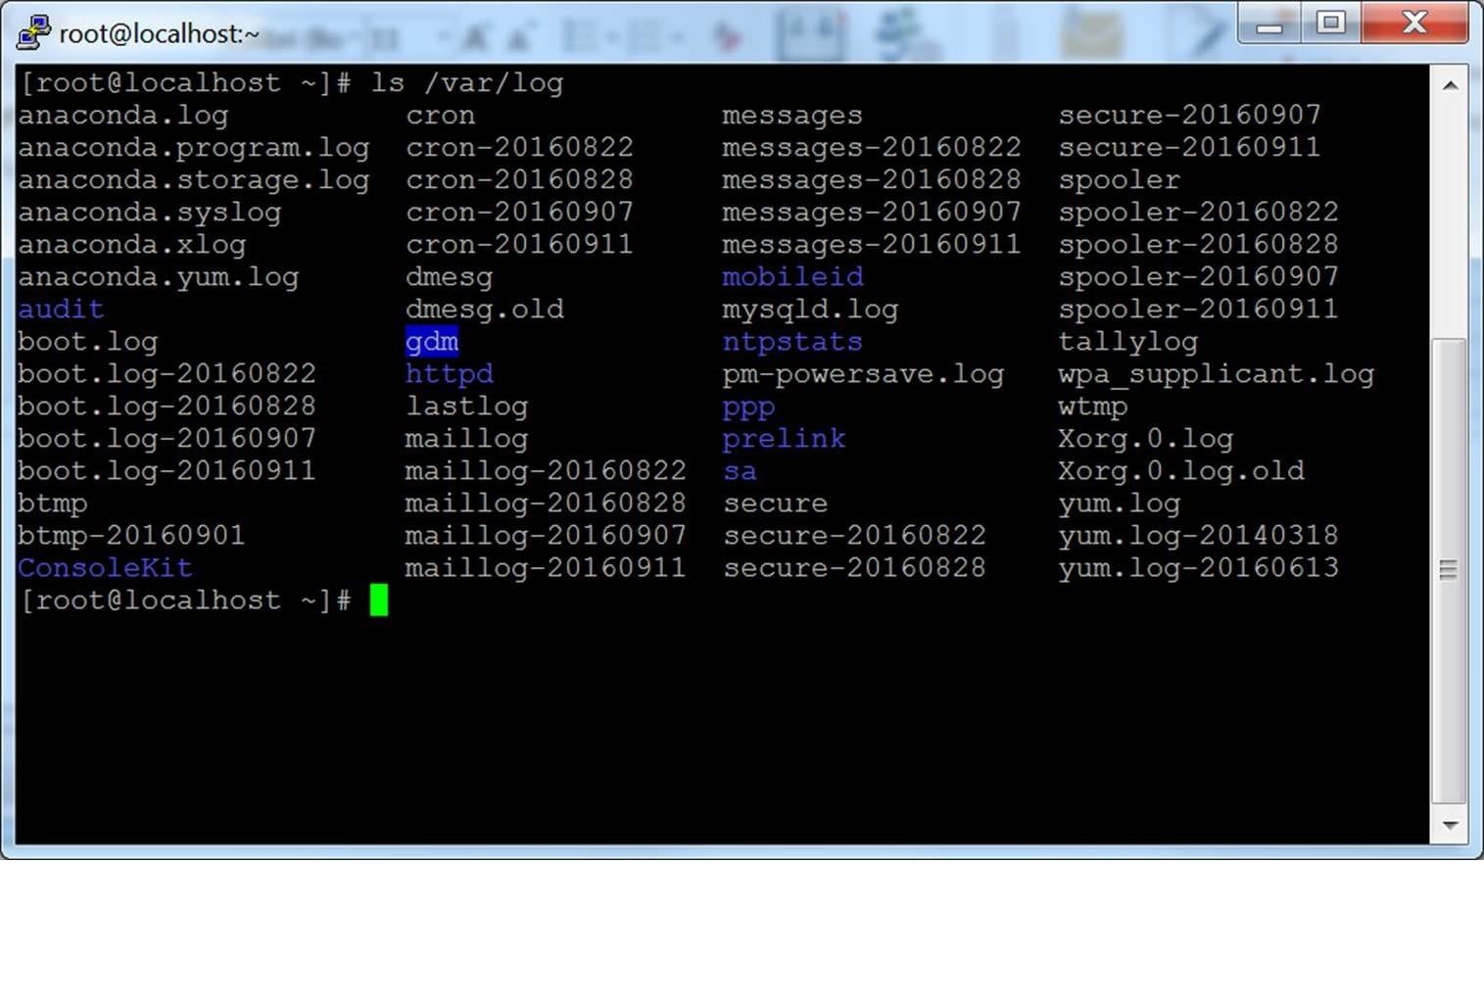
Putty Cont.

Slide 14
Useful Remote Commands
Command | Meaning | Syntax | Usage
pwd | Print Working Directory | pwd | Displays the current directory path.
ls | List Directory Contents | ls | Shows all files and folders in the current directory.
cd | Change Directory | cd <directory_name> | Moves to another directory. Example: cd Documents
mkdir | Make Directory | mkdir <folder_name> | Creates a new folder. Example: mkdir Lab
touch | Create File | touch <file_name> | Creates an empty file. Example: touch demo.txt
nano | Editing File | nano <file_name> | Opens File in Editor.
cat | Prints File Content | cat <file_name> | Displays content of file.
whoami | Current User | whoami | Displays the username of the logged-in user.

Slide 15
Exercise
install, configure, and establish a Telnet connection between two systems using the provided reference materials.
Reference Materials :
📖 Windows – Telnet
https://www.makeuseof.com/enable-telnet-windows/
📖 How to use Putty:
https://thehost.ua/en/wiki/administration/ssh/ssh-connect
📖 Linux - Telnet
https://www.baeldung.com/linux/telnet

Slide 16
Thank you

